Slide 1
All for One Network, One Network for All
Development of a Statewide Network for All Users
North Carolina Model User Group Meeting, November 13, 2024
Jonathan Avner, WRA

Slide 2
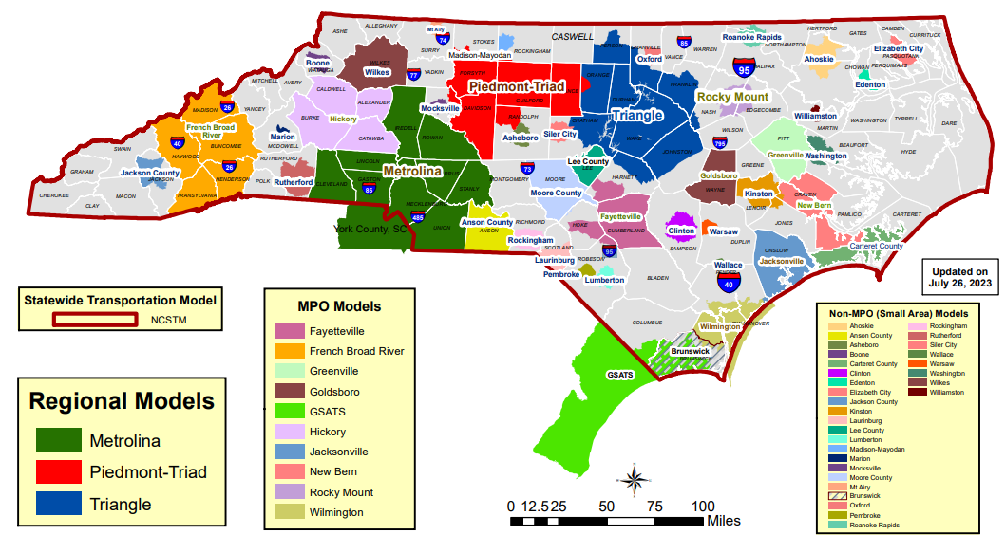
Problem Statement: How can networks be developed EFFICIENTLY that are highly ACCURATE and CONSISTENT across statewide and MPO areas when developed and maintained independently?

Slide 3



Problem Statement
Efficiency
Accurate
Consistent
Simplify the network building process to support multiple geographic scales of modeling and tools
  Statewide
  MPO
  Project Applications of TDM
Create vertical integration with data sources
  Project databases
  MPO <-> Statewide Models
  Centerline / Route Data
Saves Time
Reduces Error

Slide 4
Centralized Network Database
Statewide Model
MPO Models
Project Information
Centralized Network Database
Developed from best information at the time
  MPO Networks
  Statewide Model
  Project Definitions
  True Source of Attributes

Slide 5
Centralized Network Database
MPO
Statewide
Centralized Network Database
Create networks for all users
  MPO networks
  Statewide Model
  Regional Models (Multiple Regions)
  Multiresolution Networks
  Multimodal

Slide 6
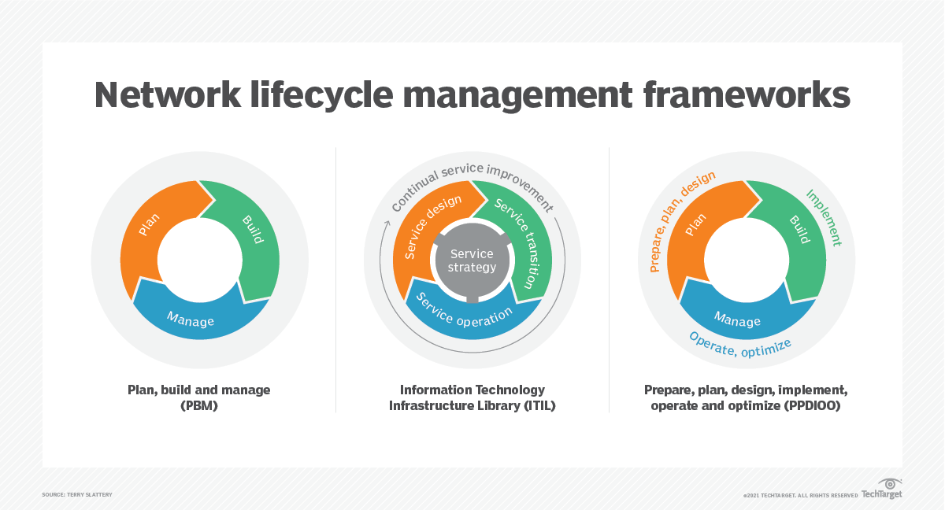
Considerations of the Lifecyle of a TDM Network

Slide 7
System Design
Plan
How code and manage highway projects?
Build
Combine information maintained by the State and MPOs
Manage
Create networks to be used by the Statewide and Regional Models
Who maintains attributes?

Slide 8

Centralize Network Database: Plan, Build and Manage
Network Model Life Cycles
Plan | Network Needs
 | Geographic Resolution
 | Geographic Representation
Build | Attribute Development
 | Geographic Coding
 | Modal Networks
Manage | Project Coding
 | Scenario Development
 | Attribute Changes

Slide 9


System Design Considerations
Software Environment
  User Experience of Staff
  Native Understanding of Model Networks
  GIS Environment
  Custom Tool Development
  Enterprise Environment
 | Experience | Model Platform | GIS
TransCAD
ArcGIS
???

Slide 10
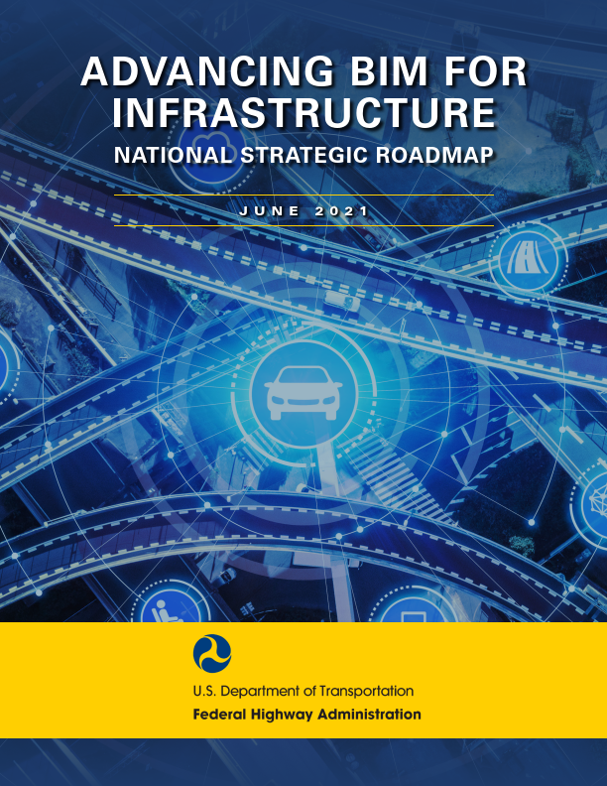
Building Information Modeling
Structuring, managing and using data
Liberates data from siloed systems and makes it easier for automated processes to generate asset information and distribute it to anyone who needs it when they need it.
Conference on
Innovations in Travel Analysis and Planning

Slide 11
Silo Datasets and Process
Attribute Information (LRS)
Lanes
Geometry
Performance Information (TMS)
Vehicle Counts
Speeds
MSTM
Land Use
Multimodal Forecasts
Functional Class
Pavement
Trucks
Events
Transportation Business Units (TBUs)
TFAD
TSO
CHART
MDTA
Travel Patterns
Freight Forecasts
Conference on
Innovations in Travel Analysis and Planning

Slide 12
BIM – Connecting the Pieces
BIM
Model
Reporting
Data
BUs
Building Information Modeling (BIM)
  Creating a linkage between MSTM, TMS and LRS provides TBUs to access information
Conference on
Innovations in Travel Analysis and Planning

Slide 13


Case Studies
Ohio
  Centralized support for MPO (Small & Large) and Statewide Model
  Standard network attribute scheme
  Lack of resources at the MPO level to support model maintenance
Maryland
  Driven by obsolete network management tools for both statewide and MPO models
  Overlap in model areas

Slide 14
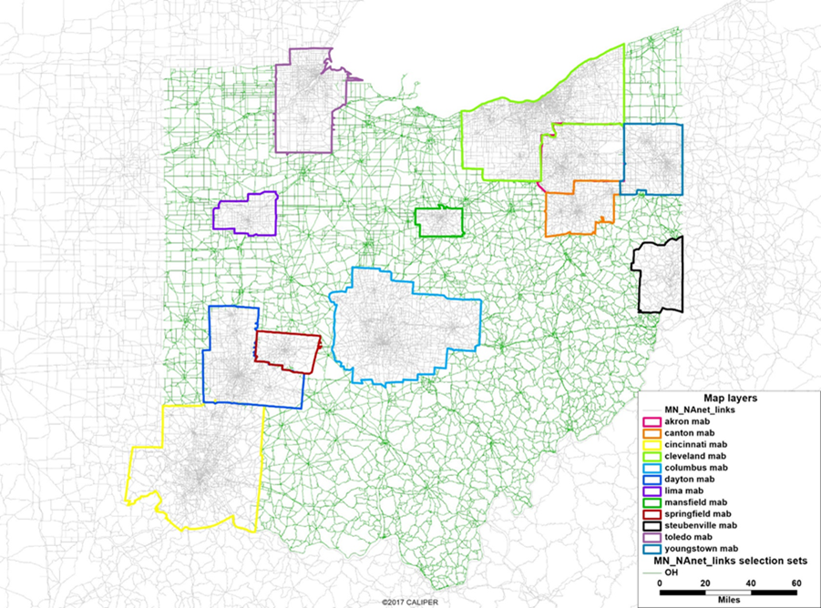
Ohio Statewide Network Database
Staffing: MPOs have limited resources to support model maintenance
Suitability
  ODOT maintains a consistent network data dictionary across models (MPOs & SWM)
  Centralized support of MPO models

Slide 15
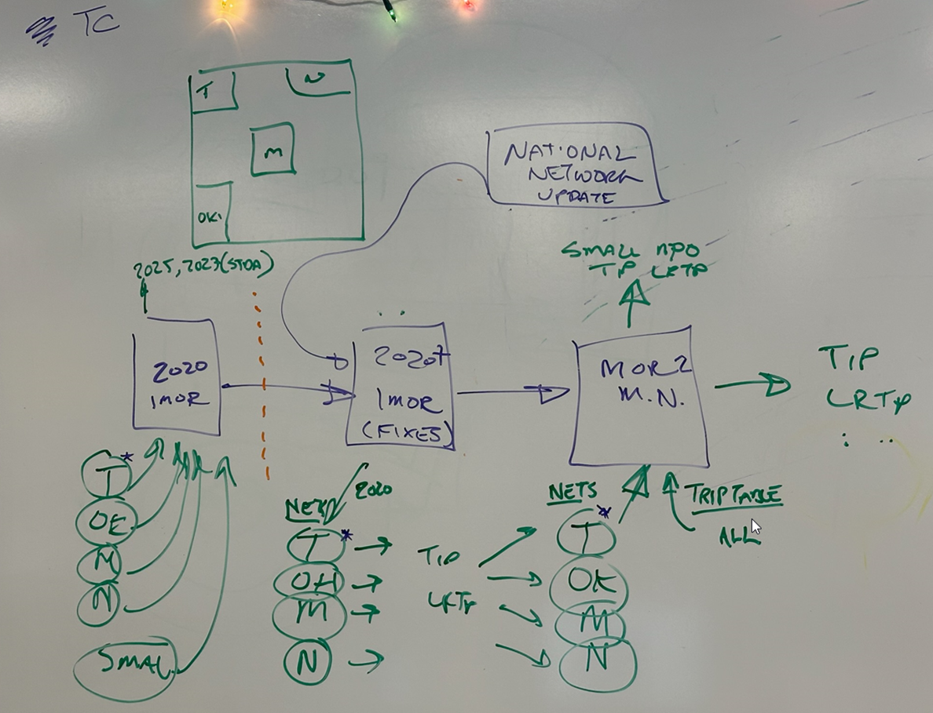
Ohio Statewide Network Database
Decision: create a single network data model
Need to 2020 base network
  Incorporate latest MPO networks
  Statewide Network
  National Network
Corrections / Updates / Consolidation
Network Management Tools

Slide 16
Ohio: Importance of MPO Networks
Local knowledge
Detail to support the MPO tools
  Ohio Medium Small (OMS) Models
  3C Models
  Traffic Forecasting

Slide 17
Ohio: Building Statewide Network Database
Conflation and Ground Truthing
MPO / Statewide Consistency
Attribute Accuracy

Slide 18
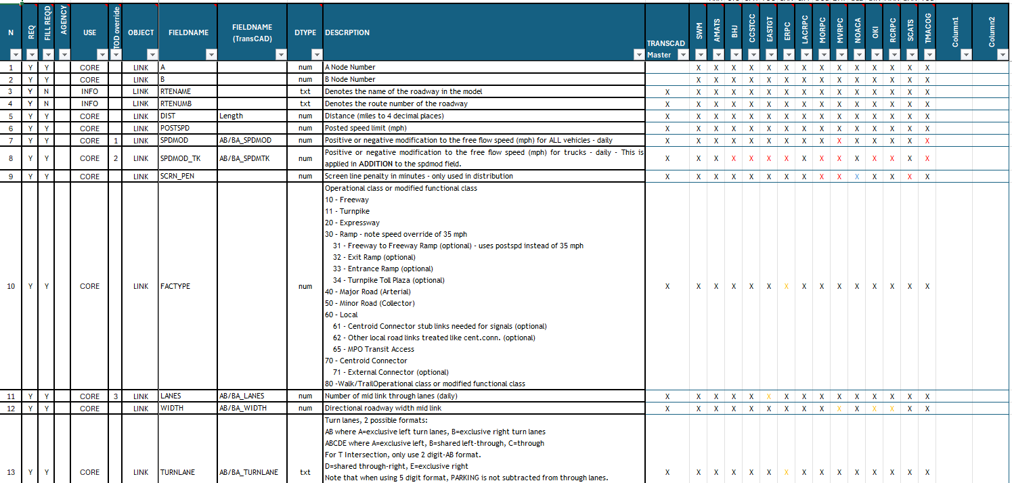
Ohio: Network Attributes

Slide 19
Single Network Data Model

Slide 20
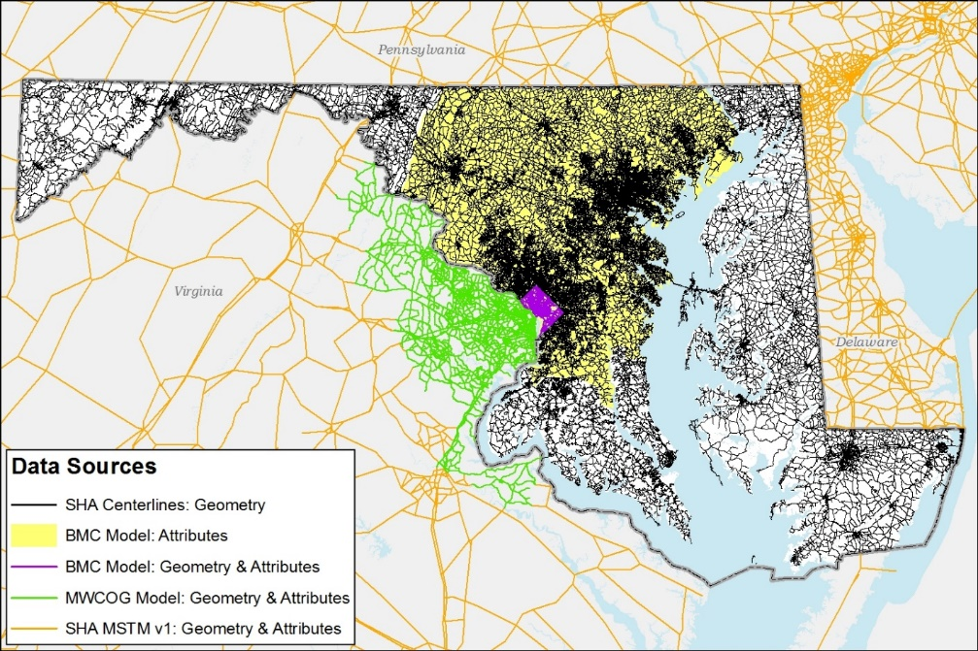
Maryland: Consolidation of MSTM and BMC Network and Tools
Overlap: Maryland Statewide Model, Baltimore Metropolitan Council (BMC) and Metro Washington Council of Government (MWCOG) models
  Network consistency
  Project coding across models
Network Management: both MSTM and BMC manage networks via ArcMap customized tools
  Reconcile the network needs of two agencies
  Combine resources

Slide 21
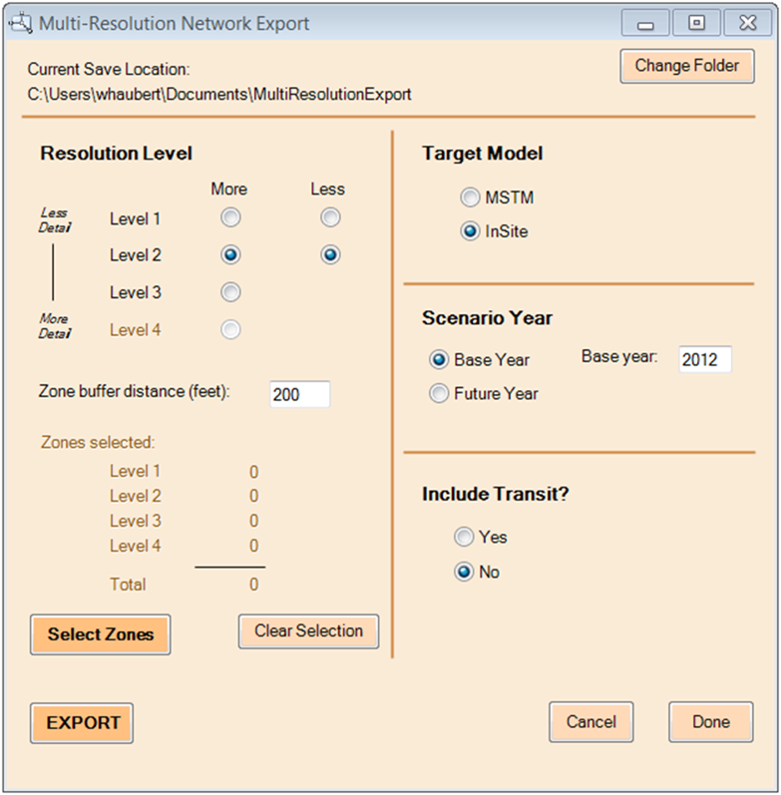
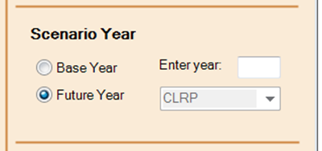
Maryland STM Network Tools
Graphical User Interface
  Selection of resolution
  Definition of buffer area for resolution transition
  Management of selectin process
  Selection of attribute scheme
  Model year, and scenario
  Include transit data

Slide 22
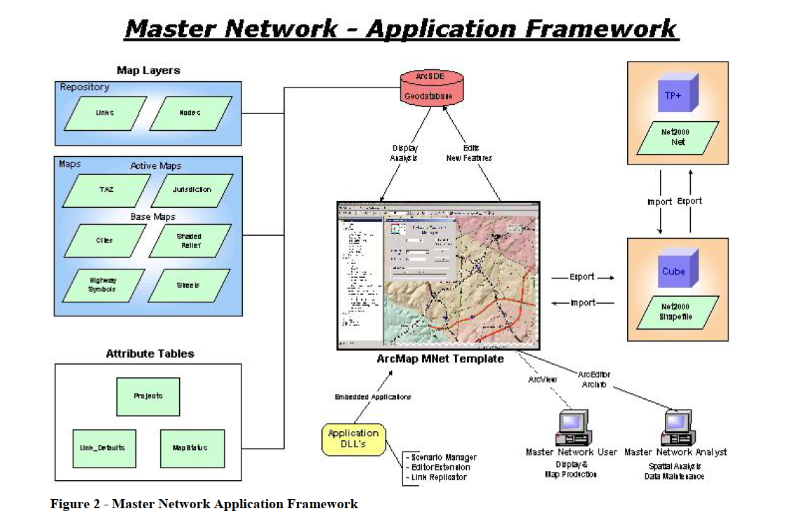
BMC Network Tools

Slide 23
Maryland Phased Solution
Phase 1
Universal Tool
Independent Networks
Phase 2
Centralize Data
Extract Required Networks
Phase 3
Management
Multiple User Environment

Slide 24



Phase 1: Universal Tool Development (Plan)
Focus on development of a consistent tool to support both MSTM and BMC
  Address immediate need to transition away from ArcMap
  Take advantage of efficiencies by working together

Slide 25
Phase 2: Centralize Data (Build)
Because of overlap between MSTM and BMC there is no need for maintaining of independent networks for the same area
Attribute Management: BMC and MSTM use similar attributes but not identical
Attribute | Model | Description | Note | Value
AMLIMIT | Both | AM HOV restriction | indicates HOV restricted links by time of day | 2=2 HOV only 3=3+ HOV only 4= No Trucks 9=No Vehicles
PMLIMIT | Both | PM HOV restriction
OFFLIMIT | InSITE | OFF-PEAK HOV restriction
OPLIMIT | MSTM
FT | InSITE | functional type | roadway functional class | 1-36
SWFT | MSTM |  |  | 1-26
SPDP / PSTSPD | Both | Posted Speed Limit | speed limit of a link
TOLLCODE | InSITE | toll road identifier | identifies toll road links | 1 existing toll facility 2, 3 Electronic Tolling, video surcharge
AMLANE | Both | number of lanes (AM) | lanes in a single direction (morning rush hour) | 1-7 lanes
PMLANE | Both | number of lanes (PM) | lanes in a single direction (evening rush hour) | 1-7 lanes
OFFLANE | InSITE | number of lanes (off-peak) | lanes in a single direction (off-peak hours) | 1-7 lanes
OPLANE | MSTM
AREATYPE | Both
FFSPEED | InSITE | Initial Off Peak Free Flow Speed
CONGSPD | InSITE | Initial Off Peak Congested Speed
FFSPD | MSTM | Initial Off Peak Free Flow Speed
CONGSPD (2) | MSTM | Initial Off Peak Congested Speed
TOLLCOSTOFF | InSITE | Toll Rate | Peak Hour ($)
TOLLCOSTPK | InSITE | Toll Rate | Off Peak Hour ($)
TOLLOP | MSTM | Toll Rate | Peak-Hour ($)
TOLLPK | MSTM | Toll Rate | Off Peak Hour ($)

Slide 26
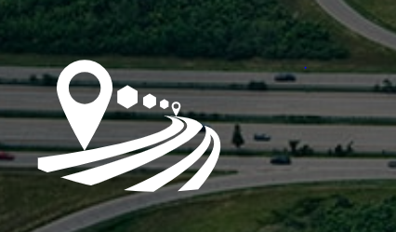
Phase 3: Common User Environment (Manage)
Software Environment
  User Experience of Staff
  Native Understanding of Model Networks
  GIS Environment
  Custom Tool Development
  Enterprise Environment
 | Experience | Model Platform | GIS
TransCAD
Cube
ArcGIS

Slide 27
Conclusion
Benefits
Challenges

Slide 28
Benefits of a Centralized Network Database
Cost: reduce costs in managing multiple versions of the same geography
Accurate: rely upon consistent data source to establish truth in data
Scalability: support of multiresolution modeling
Project Coding: consistent representation of projects across jurisdictions
Flexibility: able to support different attributes based on geography from single data source
Staffing: able to support jurisdictions with minimal support
Standardization: promote a standard network definition
Prioritization: simplify coding of networks for project prioritization (consistent E+C)
Accuracy: updates of attributes are applied universally
Flexibility: able to support creating regional and multiregional models

Slide 29
Challenges of a Centralized Network Database
User Needs: Meeting all user needs and use cases
Ownership: Who will own the network
Truth in Data: What will be the data sources defined as truth
Attributes: Establishment of a consistent attribute scheme. Will everyone get on board?
Software Solution: What software can be used to meet the specifications of a common editing environment
Resolution: How manage different resolution of models (what links to include)
Centroid Connectors: will connectors suit multiple model needs
Validation Overrides: changes required to support validation are they appropriate to other uses
Software: what if different agencies diverge in software
Unknowns: ??

Slide 30

Questions?
Jonathan Avner
javner@wrallp.com
Ohio: Rebekah Straub
Rebekah.Straub@dot.ohio.gov
Roberto Miquel
rmiquel@wrallp.com
Maryland: Rana Shams
rshams@mdot.maryland.gov

